Slide 1
Does Prevention Pay?
HSPM 714 J50

Slide 2
Does Prevention Pay?
Pay in what sense?
Cost-benefit
Cost-effective
Cost-saving

Slide 3
Does Prevention Pay?
Pay in what sense?
Cost-benefit
  If the value of prevention’s benefit is greater than the cost
    Requires putting a dollar value on the benefit

Slide 4
Does Prevention Pay?
Pay in what sense?
Cost-effective
  If the prevention is the least costly way to achieve a health benefit

Slide 5
Does Prevention Pay?
Pay in what sense?
Cost-saving
  If the prevention pays for itself in reduced future health care cost

Slide 6
Fries, J.F., Koop, E., et al, "Reducing Health Care Costs by Reducing the Need and Demand for Medical Services,”
N Engl J Med, July 29, 1993, 329(5), pp. 321-325.
"Risky Behavior Costs Money”
  $1360 difference in annual medical claims cost between high- and low-risk persons in one group of employees.
But how much of that risk difference is amenable to intervention, and at what cost?
"Cure for Terminal Illness Has Become Extraordinarily Expensive and Inhumane."
But, the expense of treatment for terminal illness isn't growing any faster than the rest of expense of prevention and care.
  James D. Lubitz and G. F. Riley, "Trends in Medicare Payments in the Last Year of Life," NEJM, April 15, 1993, 328(15), pp. 1092-1096, reported that the 29% of Medicare spending is for people in their last year of life, but this showed no upward trend from 1976 to 1988.
Fries et al cite studies showing cost savings for health promotion at the workplace.

Slide 7
Russell, L.B., "The Role of Prevention in Health Care Reform,"
N Engl J Med, July 29, 1993, 329(5), pp. 352-354.
Russell asks: Should we claim, or require, that preventive measures pay for themselves? Her answer is No.
She criticizes justifying prevention by cost savings to the health care system because:
It's too strict. We spend money (representing social resources) on health care to feel better and live longer, not necessarily to save money later.
  Hypertension control example.
  Eddy's findings on PAP test are another example.
There's also the paradox that total costs may rise simply because prevention helps people live longer.
  Smoking cessation may add to future Social Security costs.

Slide 8
Russell, L.B., "The Role of Prevention in Health Care Reform,"
N Engl J Med, July 29, 1993, 329(5), pp. 352-354.
"Prevention should not ... be held to a higher standard than other medical services." Russell cites studies showing that prevention programs, for risk factors like hypertension and cholesterol, generally don't pay for themselves in health care cost savings.
  For example, annual PAP tests have a net life-time cost of $1000 (in 1993 dollars).

Slide 9
Expecting an HMO to maintain your health because it pays them to do so, does hold prevention to that too-high standard.

Slide 10
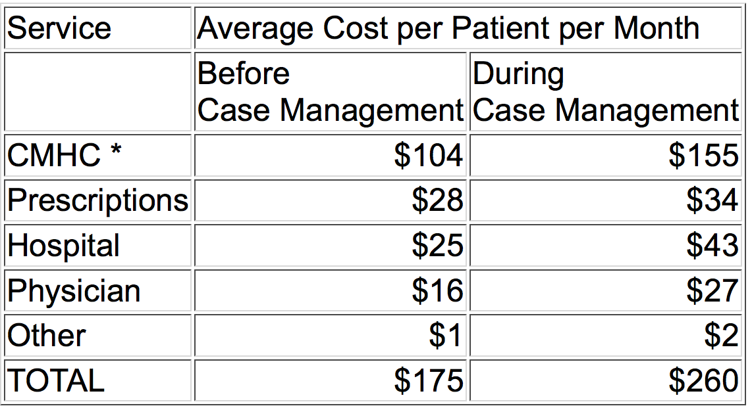
S.C. Mental Health Waiver
For schizophrenia patients in an experimental intensive case management program, 1990.

Slide 11
Footnotes
Community Mental Health Center (CMHC) costs are based on what would have been billed to Medicaid at fee-for-service rates. CMHC's were actually paid a capitated rate.
Maybe the costly case management reduced medical spending needs years later.
A private HMO, however, might not realize those savings. People change HMOs. That's necessary for a well-functioning market, but it reduces the incentive for an HMO to prevent illness, because some other HMO will get the benefit.

Slide 12
Huntington, J., Connell, F.A., "For Every Dollar Spent -- The Cost-Savings Argument for Prenatal Care,"
N Engl J Med, Nov. 10, 1994, 331(19), pp. 1303-1307.
"Everybody knows" that prenatal care saves money.
But if you examine the studies that support this claim, you see a lot of
  shoddy methodology, such as failure to control for confounding effects, and
  wishful thinking, basically assuming that prenatal care is effective.
Cost-benefit claims helped get Medicaid eligibility expansions through Congress and state legislatures.

Slide 13
Huntington, J., Connell, F.A., "For Every Dollar Spent -- The Cost-Savings Argument for Prenatal Care,"
N Engl J Med, Nov. 10, 1994, 331(19), pp. 1303-1307.
You can’t compare the cost of prenatal care for one woman
With the cost of one premature baby.
You have to compare the cost of prenatal care for all pregnant women
  Many of the women who get prenatal care would probably have normal childbirths

Slide 14
Huntington, J., Connell, F.A., "For Every Dollar Spent -- The Cost-Savings Argument for Prenatal Care,"
N Engl J Med, Nov. 10, 1994, 331(19), pp. 1303-1307.
Self-selection makes the effect of prenatal care appear larger than it actually is.
  One study didn't correct for the fact that early delivery itself means fewer prenatal visits.
Most studies assumed that an average or routine level of prenatal care was effective at reducing premature births.
  Since the 1990's the state of the art has been to give high-risk women intensive prenatal care. This intensive prenatal care does appear to be effective, but it costs more than routine care. Studies using normal prenatal care cost are, in effect, underestimating the cost of prenatal care in their calculations.
  Getting more pregnant women to prenatal care earlier requires overcoming such barriers as lack of transportation, the attitudes of the women, the attitudes of providers, and enrollment paperwork. The cost of giving more prenatal care is thus greater than the cost of the care itself.

Slide 15
Huntington, J., Connell, F.A., "For Every Dollar Spent -- The Cost-Savings Argument for Prenatal Care,"
N Engl J Med, Nov. 10, 1994, 331(19), pp. 1303-1307.
Narrow cost-benefit analysis can overlook benefits such as happier pregnancies and better relationships between moms and health care providers. These lead to better parenting, greater likelihood that the child will be immunized on schedule, better diet and hygene for mom and baby, and other better health-related habits.
And there's the Russell point -- prenatal care can be a cost-effective way to improve health, even if it doesn't save money.
One kind of prevention that does seem to be cost-saving -- reducing total health care system costs -- is contraception. See http://www.agi-usa.org/pubs/journals/2924897.html .

Slide 16
Kim and Goldie, “… HPV vaccine …”
On the assumption that the vaccine provided lifelong immunity, the cost-effectiveness ratio of vaccination of 12-year-old girls was $43,600 per quality-adjusted life-year (QALY) gained, as compared with the current screening practice.
  This is a net cost.

